Slide 1

BMS COLLEGE OF ENGINEERING (Department of Computer Applications)
Team Name : S & S
Course : Mini Project
Course Code : 16MCA5DPMP
Course Credit : 2
Team Members : Sneha V K (1BM16MCA39)
Sarthak SenGupta (1BM16MCA37)
Guide Name : Prof. Lakshminarayan P
2018 © Team S&S ( BMSCE )
21 December 2018

Slide 2

Online Course Registration System
2018 © Team S&S ( BMSCE )
21 December 2018

Slide 3
Contents
Introduction
Purpose
Existing System
Proposed System
Technology used
System requirements
Implementation
Screenshots
Conclusion
Future Enhancement
Bibliography
2018 © Team S&S ( BMSCE )
21 December 2018

Slide 4
1. Introduction
Every student has to face problem of manual registrations using forms at college for different records purpose and must be submitted with the stipulated date and time to college office without any delay. This consumes lots of time of student and prone to error is major issue and again rework needs time. Also college faculties won’t be available for various reasons to approve, it also delays the work. Lots of confusions and error takes place while filling forms and submitting. To overcome this issue we have come up with the solution “Online Course Registration System”.
2018 © Team S&S ( BMSCE )
21 December 2018

Slide 5
2. Purpose
This system acts as a replacement for manual process of course registration
which is lengthy and time consuming procedure. It not only reduces work of
student but it also reduces work of college in terms of maintaining every
Student’s registration of all semester.
2018 © Team S&S ( BMSCE )
21 December 2018

Slide 6
3. Existing System
3
Manual registration involves form filling procedure, which is time
Consuming and tedious work to do both for student and college people.
Drawbacks:
College must dedicate every semester’s first day to get course registered by students.
Any student who won’t be able to make it on dedicated day will prolong the process.
It costs paper use and time of every student as well as college staff.
Student need to remember all courses with name and code respectively.
Any mistakes on paper will cost extra forms to register, use of correctors and whiteners messes the look.
2018 © Team S&S ( BMSCE )
21 December 2018

Slide 7
4. Proposed System
Replacing manual form filling procedure to online so that it will be easy
For both student and college people in order to maintain records of all the
Students easily.
Features:
Login option for both admin and student will be provided
All information regarding the courses prescribed for particular semester should be available on the registration page making it easy to choose for student.
The student should be able to view their registered courses and select them, later submit it.
Once they are done submitting it will go to admin so that they can view who has not done the process, and insist them to complete soon.
2018 © Team S&S ( BMSCE )
21 December 2018

Slide 8
5. Technology Used
Advantages of using PHP:
It is a cross platform.
It has got easy features to connect to backend (database).
It is easy to use.
It is open source software.
Advantages of using XAMPP server:
XAMPP is portable so that it can be carried on a pen drive.
PHP error debugging is enabled by default, which helps when debugging scripts.
To develop this application we have used PHP for front end with HTML and CSS.
MySQL server for the backend support. According to us PHP is well supported
scripting language where one can design both server side and client side application
request and response in formatted way. Complete project runs on XAMPP server
that supports both PHP and MySQL. For effective GUI we have blended with HTML
and CSS.
2018 © Team S&S ( BMSCE )
21 December 2018

Slide 9
6. System requirements
Software requirements:
Sl No | Software component | Name
1 | Operating System | Windows 8 (Minimum)
2 | Front end | PHP 7.1
3 | Back end | My SQL 5.6.16
4 | Server | XAMPP 1.8.3
Hardware requirements:
Sl No | Hardware component | Name
1 | Processor | Intel Core i3-4030U CPU@ 1.90GHz
2 | RAM | 4GB
3 | Hard Disk | 1TB
2018 © Team S&S ( BMSCE )
21 December 2018

Slide 10
7. Implementation
7
Each web page in this project contains interactive interface compromising HTML, CSS design and PHP scripting in order to work dynamically. Working on this project we solved many challenges and have implemented, project is yet not completely implemented it needs lots of additional feature which we will be completing in future also conversion of web based application to mobile application is yet another improvement needed. It also holds links and database connectivity in order to make it much more interactive and user friendly.
Project has been divided into four modules they are:
1. Student
2. Admin
3. Proctor
4. HOD
2018 © Team S&S ( BMSCE )
21 December 2018

Slide 11

8. Screenshots
Fig1 Home Page
2018 © Team S&S ( BMSCE )
21 December 2018

Slide 12
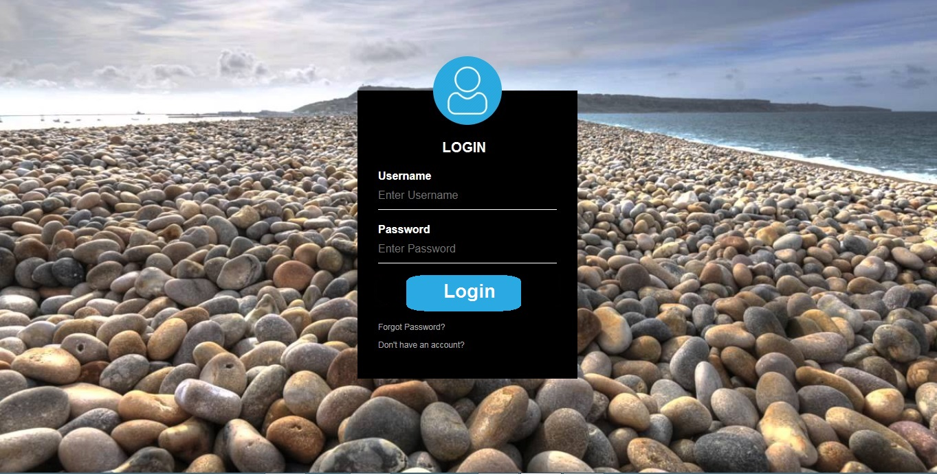
8. Screenshots..1
Fig2 Login Page
2018 © Team S&S ( BMSCE )
21 December 2018

Slide 13
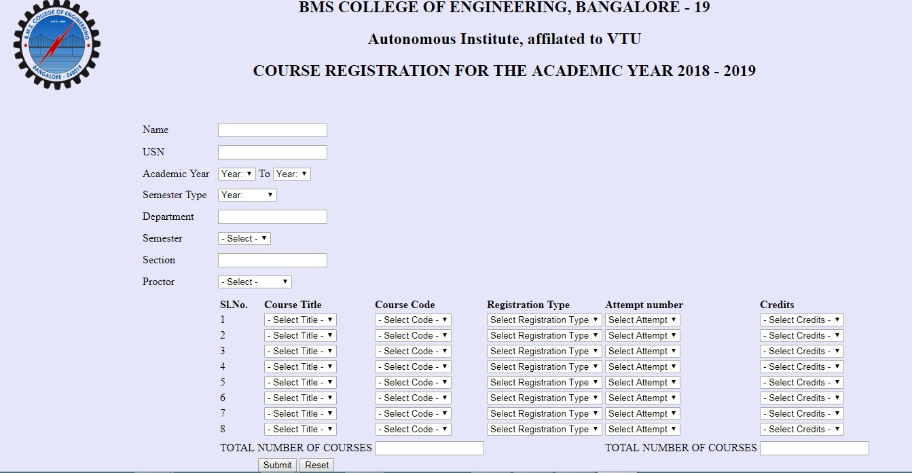
8. Screenshots..2
Fig 3 Student registration Page
2018 © Team S&S ( BMSCE )
21 December 2018

Slide 14
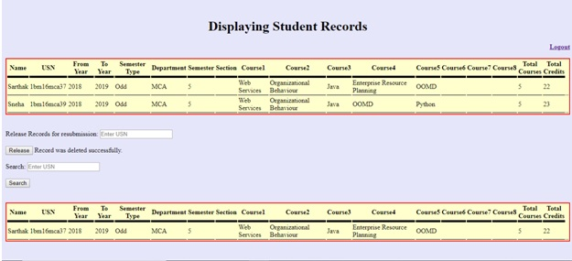
8. Screenshots..3
Fig 4 Admin Page
2018 © Team S&S ( BMSCE )
21 December 2018

Slide 15
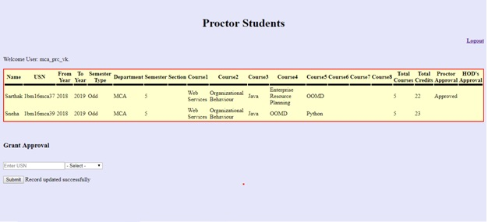
8. Screenshots..3
Fig 5 Proctor Page
2018 © Team S&S ( BMSCE )
21 December 2018

Slide 16
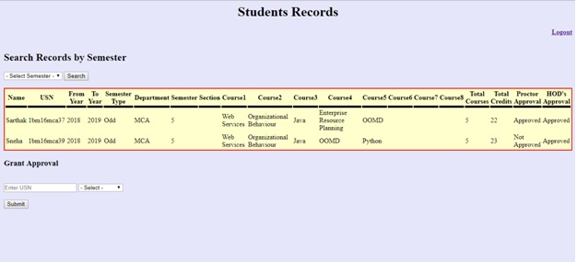
8. Screenshots..3
Fig 6 HOD View Page
2018 © Team S&S ( BMSCE )
21 December 2018

Slide 17
9. Conclusion
14
This project is relatively simple to understand and implement. If fulfills all the current requirements of college to complete course registration without much manual work. It is user friendly, student with basic computer skills can easily use the system. New features and modules can be added into the system as per user requirement. The project is flexible in that aspect. It is economical as well in the long run, requiring less manpower and money. So that it would be more comfortable and easy to implement and also to work.
2018 © Team S&S ( BMSCE )
21 December 2018

Slide 18
10. Future Enhancement
15
We can add other new modules to this ex: provisional result sheet, SGPA/CGPA Calculator.
We can develop mobile application for this proposed system.
We can add Course withdraw and fastrack sem option in this application to enhance the features as it requires almost same format to apply.
Electives selected by students can be categorized according to subjects and create a list.
2018 © Team S&S ( BMSCE )
21 December 2018

Slide 19
11. Bibliography
We would like to specify the names of some web sites which we have referred that have paid us a lot and have helped us to complete this project successfully they are:
https://www.tutorialspoint.com/sql/
https://www.w3schools.com/html/
https://stackoverflow.com/questions/6088027/how-to-retrieve-users-information-
from-the-database-for-admin-in-php
https://www.w3schools.com/php/
https://www.slideshare.net/mobile/HabiburRahman23/online-course-registration-
system-development-software-engineering-project-presentation
2018 © Team S&S ( BMSCE )
21 December 2018

Slide 20
Thank You
2018 © Team S&S ( BMSCE )
21 December 2018

